Slide 1


Lecture No 13
Production And Inventory

Slide 2











































Production is the process by which raw materials and other inputs are converted into finished products is known as Production

Slide 3



































































Slide 4

















































































Slide 5






























































Slide 6























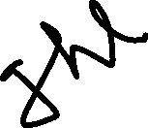
























































Slide 7


































Slide 8









































Slide 9









































Slide 10


















































Slide 11






























































Slide 12































Slide 13




























Slide 14





































Slide 15































































Slide 16
















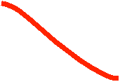

















































Slide 17


























Slide 18






































Slide 19



















































A company purchase a raw material with purchasing cost is 16 Rs. Company whole year requirement or demand is 25000 units, holding cost is 6.4 per unit for one year. The ordering cost is 32 Rs. Find out the EOQ?

